Slide 1
INTRODUCTION TO COMPUTING
Course Code: CCINCOM/L
Binary Trees and Tree Traversals
Joseph Marvin R. Imperial
Faculty
Department of Computer Science
College of Computing and Information Technologies (CCIT)
National University
Joseph Marvin R. Imperial
DATA STRUCTURES AND ALGORITHMS
NU College of Computing and Information Technologies
Course Code: CCDATRCL

Slide 2
Binary Trees
A binary tree is made of nodes, where each node contains the following:
left pointer
right pointer
a data element
The root pointer points to the topmost node in the tree. The left and right pointers recursively point to smaller "subtrees" on either side.
A null pointer represents a binary tree with no elements -- the empty tree.
Joseph Marvin R. Imperial
DATA STRUCTURES AND ALGORITHMS
NU College of Computing and Information Technologies
Course Code: CCDATRCL

Slide 3
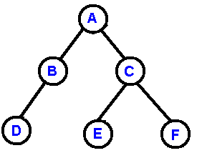
Binary Trees
Joseph Marvin R. Imperial
DATA STRUCTURES AND ALGORITHMS
NU College of Computing and Information Technologies
Course Code: CCDATRCL

Slide 4
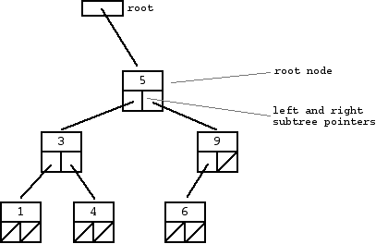
Binary Trees
Joseph Marvin R. Imperial
DATA STRUCTURES AND ALGORITHMS
NU College of Computing and Information Technologies
Course Code: CCDATRCL

Slide 5
Binary Trees
A subtree
Joseph Marvin R. Imperial
DATA STRUCTURES AND ALGORITHMS
NU College of Computing and Information Technologies
Course Code: CCDATRCL

Slide 6
Binary Trees
Another subtree
Joseph Marvin R. Imperial
DATA STRUCTURES AND ALGORITHMS
NU College of Computing and Information Technologies
Course Code: CCDATRCL

Slide 7
Binary Tree Traversals
Traversal is a process to visit all the nodes of a tree (exactly once) and may print their values too. Because, all nodes are connected via edges (links) we always start from the root (head) node. That is, we cannot randomly access a node in a tree.
There are two ways which we use to traverse a tree:
Depth First Traversal
Breadth First Traversal
Joseph Marvin R. Imperial
DATA STRUCTURES AND ALGORITHMS
NU College of Computing and Information Technologies
Course Code: CCDATRCL

Slide 8
Depth First Traversal / Search (DFS)
Depth-first search (DFS) is an algorithm for traversing or searching tree or graph data structures.
The algorithm starts at the root node (selecting some arbitrary node as the root node in the case of a graph) and explores as far as possible along each branch before backtracking.
Joseph Marvin R. Imperial
DATA STRUCTURES AND ALGORITHMS
NU College of Computing and Information Technologies
Course Code: CCDATRCL

Slide 9
Depth First Search Traversals
Pre-order Traversal
In-order Traversal
Post-order Traversal
Joseph Marvin R. Imperial
DATA STRUCTURES AND ALGORITHMS
NU College of Computing and Information Technologies
Course Code: CCDATRCL

Slide 10
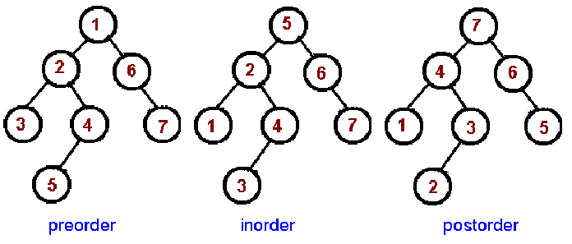
Depth First Search Traversals
Joseph Marvin R. Imperial
DATA STRUCTURES AND ALGORITHMS
NU College of Computing and Information Technologies
Course Code: CCDATRCL

Slide 11
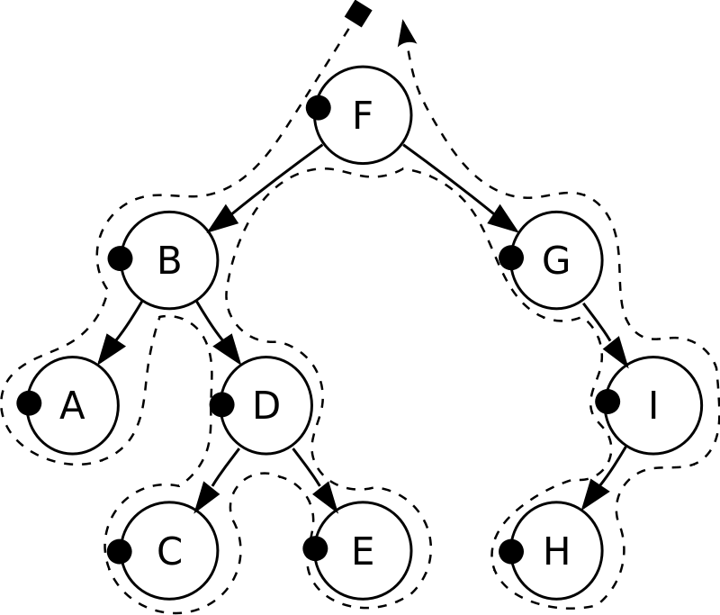
Pre-order traversal
Follows the convention: root, left, right
Algorithm for pre-order traversal
1. Visit the root.
2. Traverse the left subtree, i.e., call preorder(node)
3. Traverse the right subtree, i.e., call preorder(node)
Joseph Marvin R. Imperial
DATA STRUCTURES AND ALGORITHMS
NU College of Computing and Information Technologies
Course Code: CCDATRCL

Slide 12
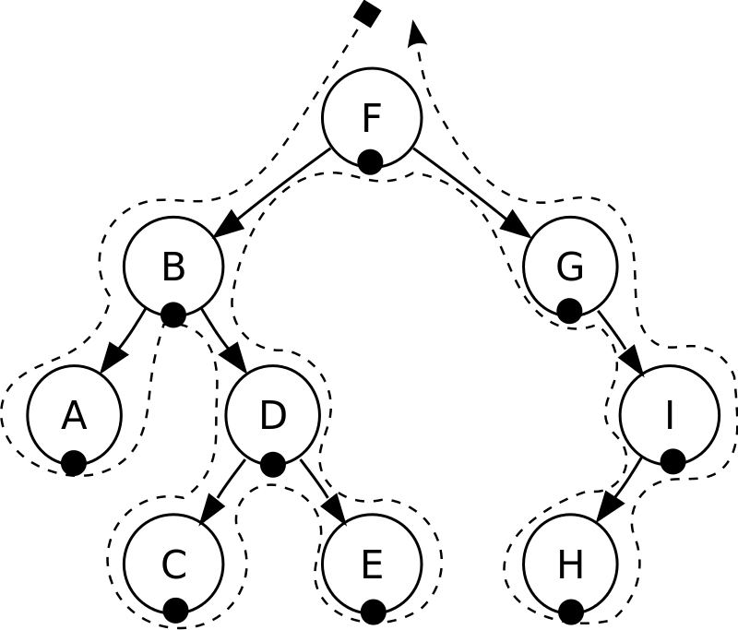
In-order traversal
Follows the convention: left, root, right
Algorithm for in-order traversal
1. Traverse the left subtree, i.e., call inorder(node)
2. Visit the root.
3. Traverse the right subtree, i.e., call Inorder(node)
Joseph Marvin R. Imperial
DATA STRUCTURES AND ALGORITHMS
NU College of Computing and Information Technologies
Course Code: CCDATRCL

Slide 13

Post-order traversal
Follows the convention: left, right, root
Algorithm for post-order traversal
1. Traverse the left subtree, i.e., call Postorder(node)
2. Traverse the right subtree, i.e., call Postorder(node)
3. Visit the root.
Joseph Marvin R. Imperial
DATA STRUCTURES AND ALGORITHMS
NU College of Computing and Information Technologies
Course Code: CCDATRCL

Slide 14
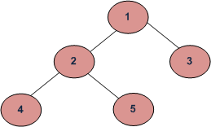
Example
Pre-order Traversal: 1 2 4 5 3
In-order Traversal: 4 2 5 1 3
Post-order Traversal: 4 5 2 3 1
Joseph Marvin R. Imperial
DATA STRUCTURES AND ALGORITHMS
NU College of Computing and Information Technologies
Course Code: CCDATRCL

Slide 15
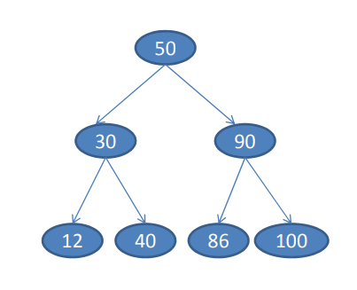
Try this
Pre-order Traversal:
In-order Traversal:
Post-order Traversal:
Joseph Marvin R. Imperial
DATA STRUCTURES AND ALGORITHMS
NU College of Computing and Information Technologies
Course Code: CCDATRCL

Slide 16
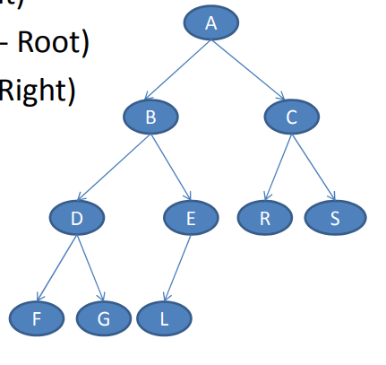
Try this
Pre-order Traversal:
In-order Traversal:
Post-order Traversal:
Joseph Marvin R. Imperial
DATA STRUCTURES AND ALGORITHMS
NU College of Computing and Information Technologies
Course Code: CCDATRCL

Slide 17
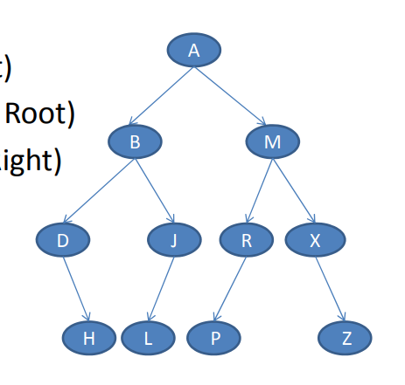
Try this
Pre-order Traversal:
In-order Traversal:
Post-order Traversal:
Joseph Marvin R. Imperial
DATA STRUCTURES AND ALGORITHMS
NU College of Computing and Information Technologies
Course Code: CCDATRCL

Slide 18
Use recursion
The simplest way to carry out a traversal is the use of recursion. A recursive method to traverse the entire tree is called with a node as an argument. Initially, this node is the root.
The method needs to do only three things:
1. Call itself to traverse the node's left subtree
2. Visit the node
3. Call itself to traverse the node's right subtree
Joseph Marvin R. Imperial
DATA STRUCTURES AND ALGORITHMS
NU College of Computing and Information Technologies
Course Code: CCDATRCL

Slide 19
Breadth First Traversal / Search (DFS)
Breadth-first search (BFS) is an algorithm for traversing or searching tree or graph data structures.
It starts at the tree root and explores all of the neighbor nodes at the present depth prior to moving on to the nodes at the next depth level.
Joseph Marvin R. Imperial
DATA STRUCTURES AND ALGORITHMS
NU College of Computing and Information Technologies
Course Code: CCDATRCL

Slide 20
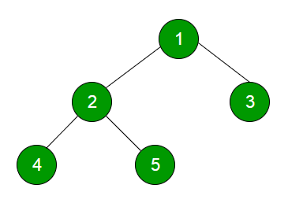
Example
Level order traversal of the above tree is 1 2 3 4 5
Joseph Marvin R. Imperial
DATA STRUCTURES AND ALGORITHMS
NU College of Computing and Information Technologies
Course Code: CCDATRCL

Slide 21
References
Carnegie Mellon University – Data Structures: http://www.cs.cmu.edu/~clo/www/CMU/DataStructures/Lessons/lesson4_1.htm
GeeksForGeeks - https://www.geeksforgeeks.org/level-order-tree-traversal/
DFS Wikipedia - https://en.wikipedia.org/wiki/Tree_traversal#Depth-first_search
BFS Wikipedia - https://en.wikipedia.org/wiki/Breadth-first_search
Joseph Marvin R. Imperial
DATA STRUCTURES AND ALGORITHMS
NU College of Computing and Information Technologies
Course Code: CCDATRCL

